Slide 1

ADNET Technologies
Catalyst Group
Catalyst Group
Partner
Program
Partner
Program
Become a partner

Slide 2
Catalyst Group Partner Program
Leverage our innovative technologies, unparalleled support, and expertise.
Solve
customer challenges
Strengthen
customer relationships
Grow
revenue

Slide 3


How It Works
It’s that simple.
01
02
03
Submit
Referral
Collaborate
your way
Earn monthly residuals and one-time commissions

Slide 4
Uncover More Opportunities
Leverage the power of our industry leading partners’ brands to:
Free up budget dollars to create new working capital.
Team to deliver integrated solutions that satisfy customer demands creating barrier to competition.
Fill solution gaps and help deliver a superior customer experience.
Customer advocate and vendor agnostic
Thoughtful advice and hassle-free support
97% Net promoter
customer satisfaction

Slide 5
Solve Customer Challenges
Today’s IT leaders face numerous challenges.
Confusing bills
Security of data
Frequent account team changes
Moving to the cloud
Do more with less
Level of support
Agility and innovation
Service delivery dates
Application performance
Resiliency and business continuity
Remote workforce
Mobile devices

Slide 6

Program Support
Personalized training tracks
Monthly commission reports
Co-marketing and business planning

Slide 7

Our Portfolio.
Connectivity
Cloud
Cybersecurity
Unified Communications
Mobility Optimization
Expense Management

Slide 8

Connectivity
Wide area networks designed for a different era are not ready for the unprecedented explosion of WAN traffic that cloud adoption brings.
Connect locations with robust, secure
and scalable bandwidth
Optimize application performance
Efficient and effective collaboration

Slide 9

Cloud
Leverage the cloud to improve agility, innovation, and disaster recovery.
Scalability and flexibility
On demand availability
Enhanced security

Slide 10

Cybersecurity
We empower organizations to fortify their defenses and stay ahead of potential security breaches.
Protect your brand
Comprehensive assessment of vulnerabilities and risk factors
Recognizing and intercepting threats before they make an impact

Slide 11

Unified Communications
Seamlessly connect through instant calling, conferencing, messaging, video, and screen sharing, whether it's with individuals or entire groups.
Streamline communication channels
Enhanced team collaboration
Reduce operational costs

Slide 12

Mobility Optimization
Reduce costs and streamline mobility management with no changes in carriers, devices or contract terms.
Lower operational costs
Improved mobility management
Enhanced productivity

Slide 13
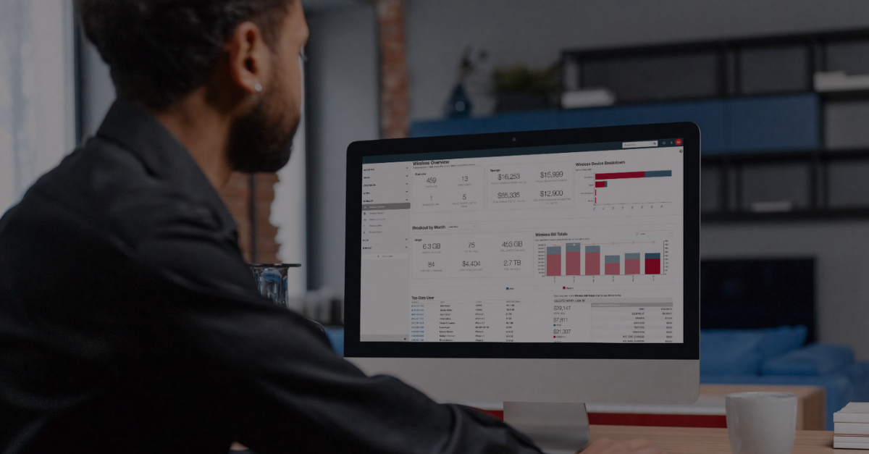
Expense Management
A meticulous audit of telecom bills and contracts to identify discrepancies, reduce costs, and uncover hidden charges.
Optimize and control costs
Clear detailed inventory of all voice, data and mobility services
Streamline multiple carrier bills
into one invoice

Slide 14
Partners numerous challenges.
AT&T Business
Comcast Business
Cox
Crown Castle
Frontier
Lumen
Masergy
MetTel
NHC
Ring Central
Spectrum
Thrive
TierPoint
Verizon
Vonage
Zoom
* Select sample of providers

Slide 15

Now is the time to join
Catalyst Group Partner Program
Learn more at thectg.net/partner

